Slide 1
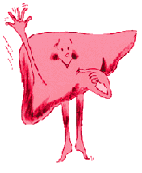
Medicines issues in liver disease
Penny North-Lewis
Paediatric Liver Pharmacist
Leeds Children’s Hospital
September 2019

Slide 2
Where is the liver?

Slide 3
What does the liver do?
Glucose homeostasis
Synthesis (e.g. albumin & clotting factors, cholesterol)
Storage e.g. vitamin A and D
Immunological e.g. filtering antigens
Bile production and secretion
Metabolism e.g drugs, hormones, lipids, toxic products such as ammonia

Slide 4
Plan
Types of questions that come to MI and why it is so hard to answer them!
Understanding liver dysfunction
Case presentation

Slide 5
Aim
Understand liver the principles of drug handling in patients with liver dysfunction
Be able to select an appropriate drug and dose for a liver patient – or at least know where to start.

Slide 6
Types of enquiries
Can I use XXX in my patient with liver failure/disease/dysfunction?
Has this drug caused hepatoxicity?
livertox database - https://livertox.nih.gov/
Existing liver dysfunction does not increase risk of hepatotoxic reaction but makes it more difficult to manage

Slide 7
Why the problem?
Poor understanding of liver dysfunction
Lack of information in regular sources e.g BNF, SPC (misinformation/lack of data)
Lack of research, small numbers of patients with specific conditions
No easy equation

Slide 8
First principles
Identify extent and type of liver dysfunction
Consider how this will affect drug handling
Consider how the drug may affect the patient – side effects, pharmacodynamic effects
Remembering the whole patient

Slide 9
Causes of liver disease
Metabolic & inherited – CF, Alagille, tyrosinaemia, Wilson’s
Autoimmune – AIH, PSC, PBC
Structural – biliary atresia, choledochal cysts
Infection – hepatitis B, C
Alcoholic liver disease
Non-alcoholic fatty liver disease
Cancer – usually underlying cirrhosis

Slide 10
Causes of liver dysfunction
Ischaemia
Infection – H1N1, CMV, EBV, malaria…
Multi-organ failure
Drugs/TPN
Trauma
Oncological – metastases
Gallstones, pancreatitis

Slide 11
Terminology - Hepatocellular
Hepatitis
Inflammation of hepatocytes
Fibrosis
An increase in connective tissue in the liver – reversible

Slide 12
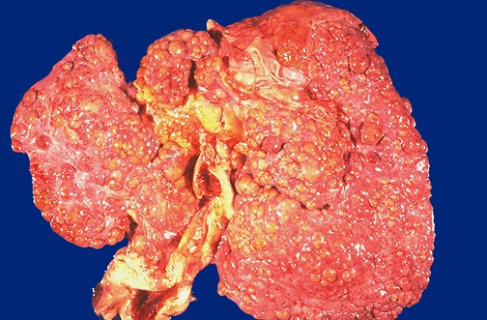
Terminology - Hepatocellular
Cirrhosis
Widespread disorganised nodules in the liver combined with fibrosis
Compensated cirrhosis
When a cirrhotic liver continues to function

Slide 13
Terminology - Hepatocellular
Cirrhosis
Widespread disorganised nodules in the liver combined with fibrosis
Compensated cirrhosis
When a cirrhotic liver continues to function
Decompensated cirrhosis
When a cirrhotic liver can no longer function adequately – signs eg coagulopathy occur

Slide 14
Terminology - Cholestasis
Intrahepatic
Extrahepatic

Slide 15
Why?
Cholestasis
Impaired elimination of biliary cleared drugs, malabsorption of fat soluble drugs
Hepatocellular damage
Impaired metabolism, reduced protein binding, deranged distribution …

Slide 16
Helps to decide how to modify drug therapy and to categorise patient into one of the following types:
Hepatitis
Cholestasis
Cirrhosis – compensated
Cirrhosis – decompensated
Acute liver failure

Slide 17
Next stage - drug considerations
Pharmacokinetics
Pharmacodynamics
Adverse drug reactions

Slide 18
Absorption
Ascites may impair absorption e.g. diuretics
Bigger doses or IV
Cholestasis may impair absorption of fat soluble drugs e.g. fat soluble vitamins
Bigger doses

Slide 19
Distribution
Ascites will increase volume of distribution for water soluble drugs
Bigger doses per kg
Low albumin will alter amount of free drug if highly protein bound
Reduced doses

Slide 20
Metabolism
Decompensated cirrhosis or acute liver failure - reduced number of functioning hepatocytes
Reduce dose or increase interval
Portal hypertension - reduced first pass metabolism if highly extracted drug e.g. propranolol, lidocaine
Reduce dose

Slide 21
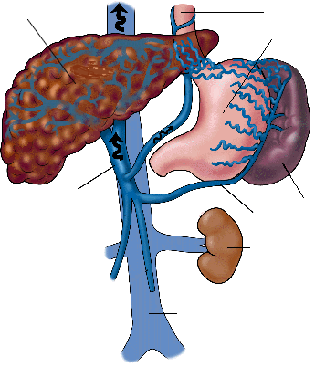
- Portal hypertension
Liver
Oesophagus
Stomach
Portal Vein
Spleen
Splenic vein
Kidney
Inferior vena cava

Slide 22
Elimination
Cholestasis – biliary cleared drugs may accumulate
Caution if active/toxic metabolites are produced, possibly not important if inactive
Compensatory pathways e.g. renal if reduced biliary clearance?

Slide 23
Pharmacodynamcis
Increased receptor sensitivity
More permeable BBB
Increased respiratory depression with opioids

Slide 24
Side Effect Profile
Drugs with the following side effects may need to be avoided/used with caution:
Pruritus
Coagulation defects
GI ulceration
Constipation
Effects on electrolytes and fluid balance
Sedation
Renal toxicity

Slide 25
Which analgesic can you use in a patient with liver disease?
Paracetamol
Ibuprofen
Morphine
Don’t know
Need more information
Notes:
Cardiac surgery patient who had a long cross clamp time resulting in raised ALT of 800 and an INR of 2.1 Now extubated this morning so still on PICU and in pain post op.
Which analgesic would be safe to use?
I’d like you to commit to an answer!

Slide 26
Paracetamol
Hepatic metabolism (multiple pathways)
Need glutathione – stores may be reduced in the severely malnourished
Hepatotoxic in overdose
oxidation conjugation with Mercapturic acid/
Paracetamol CYP2E1 NAPQI glutathione Cysteine acid conjugates
conjugation conjugation with protein
sulfhydryls
Glucuronide Sulphate
Complexes
Hepatotoxicity

Slide 27
Ibuprofen
Lipid soluble
99% protein binding
Extensive hepatic metabolism
Side effects?
GI ulceration
Inhibition of platelet aggregation
Renal impairment
Fluid retention and electrolyte abnormalities
Hepatotoxicity

Slide 28
Morphine
Low protein binding
Extensive hepatic metabolism, first pass >50%
Biliary excretion and enterohepatic recirculation
Side effects?
Sedation, respiratory depression
Constipation
Pruritus
Notes:
So which liver patients can have morphine? And when would you need to be careful? What would you do with the dose?

Slide 29
Case story
7 week old baby – prolonged jaundice
Bilirubin 132 (conjugated 97), ALT 104
Pale stools, dark urine
Hungry baby, not quite thriving
USS – absent gall bladder, triangular cord sign. ∆ biliary atresia = Profound extrahepatic cholestasis

Slide 30
Bilirubin (3-20 micromol/l)
Haem of erythrocytes
bilirubin
plasma
albumin (unconjugated)
hepatocyte (conjugated & water soluble)
bile
faeces
Unconjugated
Increased production (haemolysis)
Decreased conjugation (Gilberts, neonate, cirrhosis)
Conjugated
Intrahepatic cholestasis
Extrahepatic cholestasis (gall stones, BA)

Slide 31
Transaminases (0-35iu/L) (ALT & AST)
Enzyme released from hepatocytes when damaged
Markers of hepatocellular injury
High elevations in acute injury (in several thousands)
Can be normal in severe chronic liver disease (cirrhosis)
Notes:
Transaminases are found in hepatocytes and are released when hepatocytes are damaged. But we have a problem with specificity as they are also found in heart, muscle and kidneys

Slide 32
Biliary atresia
Kasai
25% success, 25% fail.

Slide 33
PK/PD/ADR considerations
Cholestatic patient
Impaired absorption of lipophilic drug
Displacement of bilirubin from binding sites (and vice versa)
Impaired excretion of biliary cleared drugs
Potential fat sol vit deficiency = coagulopathy CHECK
Potential for pruritus

Slide 34
Choice of analgesia
Paracetamol
Fine to use
Ibuprofen
Possible impaired oral absorption (lipid soluble drug)
May displace bilirubin from protein binding sites or v.v.
Caution if pt has raised INR due to vit K malabsorption
Prefer avoid but could use with careful consideration
Morphine
Possible impaired excretion
Pruritus, bile duct spasm
Yes – normal dose but monitor and use prn

Slide 35
Case story
6-12 months of age
Recurrent episodes of cholangitis
Intermittently raised bilirubin and ALT – never returning to baseline

Slide 36
Case story
12 months of age
ALT 240, Bilirubin 120, INR 1.4, Albumin 36
USS – echogenic liver, hepatomegaly
FIBROSIS

Slide 37
Prothrombin Time (~13 secs) or INR (0.9-1.2)
Decreased synthesis of clotting factors
Vitamin K malabsorption
Useful prognostic indicator of impending liver failure e.g. acute liver failure or decompensated chronic liver disease
OR

Slide 38
Case story
15 months of age
ALT 180, Bilirubin 180, Alk Phos 560 INR 1.5 (corrects with vit K), Albumin 29
USS – cirrhotic liver, signs of portal hypertension on dopplers
Ascites – managed with diuretics and HAS
Pruritus
Compensated cirrhosis

Slide 39
PK/PD/ADR considerations
Compensated cirrhosis
Absorption in ascites and cholestasis
Distribution
Ascitic fluid
Protein binding
Metabolism
First pass metabolism
Possibly reduced metabolism/prodrugs
Elimination
Consider cholestasis

Slide 40
PK/PD/ADR considerations
Compensated cirrhosis
Risk of bleeding – varices, coagulopathy
Sedation – encephalopathy
Pruritus
Electrolytes and fluid balance – encephalopathy, ascites
Renal toxicity – cirrhosis, hepatorenal

Slide 41
Choice of analgesia
Paracetamol
Fine to use
Ibuprofen
Risk of bleeding, renal toxicity, sodium and water retention
AVOID
Morphine
Impaired metabolism possible accumulation
Varices may affect first pass
Sedation, resp depression – encephalopathy
No/Maybe – half dose but monitor and use prn with wider intervals

Slide 42
Case story
18 months
ALT 60, Bili 300, INR 1.6 (not corrected with vit K), Albumin 25
Variceal bleed secondary to portal hypertension
Ascites refractory
Irritable - ?encephalopathy
Decompensated cirrhosis

Slide 43
Choice of analgesia
Paracetamol
OK but reduce dose to tds (be aware of weight of patient)
Ibuprofen
Poor metabolism, accumulation
Bleeding risk, renal toxicity, fluid and electrolyte disturbance AVOID
Morphine
Impaired metabolism/accumulation
Sedation, respiratory depression
No unless can be closely monitored – quarter to half dose, 8-12 hourly. If tolerated may increase dose but keep interval the same.

Slide 44
Case study
Liver transplant 4 months ago.
Living related – mum was donor
LFTs normal, good tacrolimus levels …
Most meds fine to use
Don’t forget interactions
Still caution with renally toxic meds because of tacrolimus
Co-morbidities

Slide 45
Case story
And mum??
Regeneration within 2 months
No sequelae

Slide 46
Key messages – when to worry
Cirrhosis, esp decompensated
Varices
Ascites
Cholestasis/low albumin

Slide 47
Summary
Work out what is wrong with your patient’s liver and how bad it is
See if the pharmacokinetics of the drug you want to use could be affected
Check the drug doesn’t have side effects which could harm the patient
Advise accordingly

Slide 48
Sources of further information
Medicines Q&As on NELM
Drug PK data – Dollery, micromedex, SPC
Drugs and the Liver!
Caution with interpreting references

Slide 49
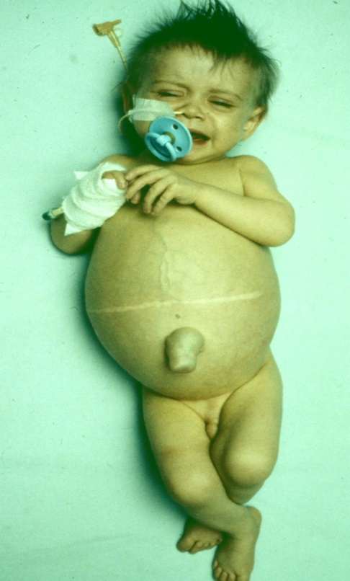
Any questions?

Slide 50
Child-Pugh score – cirrhosis only
Score | 1 | 2 | 3
SBr | <34 | 34-51 | >51
Albumin | >35 | 30-35 | <30
INR | <1.7 | 1.7-2.3 | >2.3
Ascites | None | Easily controlled | Poorly controlled
Encephalopathy | None | Minimal | Advanced
A = 5-6 (mild), B = 7-9 (moderate), C ≥ 10 (severe)

